Slide 1
TPS for Business
By Hassan Abioye, Elizabeth Nowak, Merrick, Kahasim Brown, Ane Jademi

Slide 2
Summary
Introducing TPS: Token Positioning System
Purpose: To track and manage costs associated with verbal database queries.
Notes:
TPS for business was designed to help managers keep track of chatbot usage costs.

Slide 3
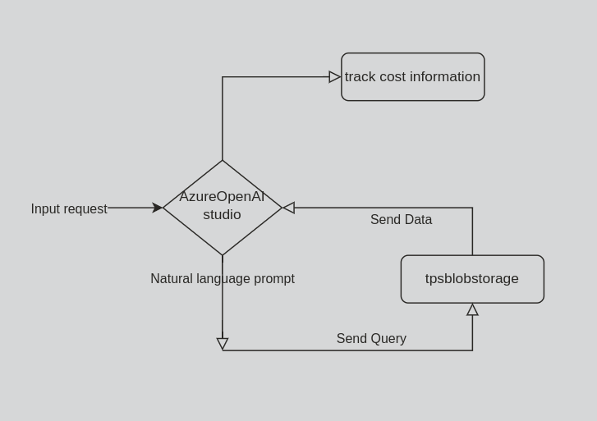
Goal
Set up natural language prompts to query database
Collect the costs of usage and data surrounding their usage
Send the above information to a secondary table to simplify cost management
Notes:
Our plan was to set up a chatbot which would use natural language queries to give local weather information, or global energy information to users, then track usage costs.

Slide 4
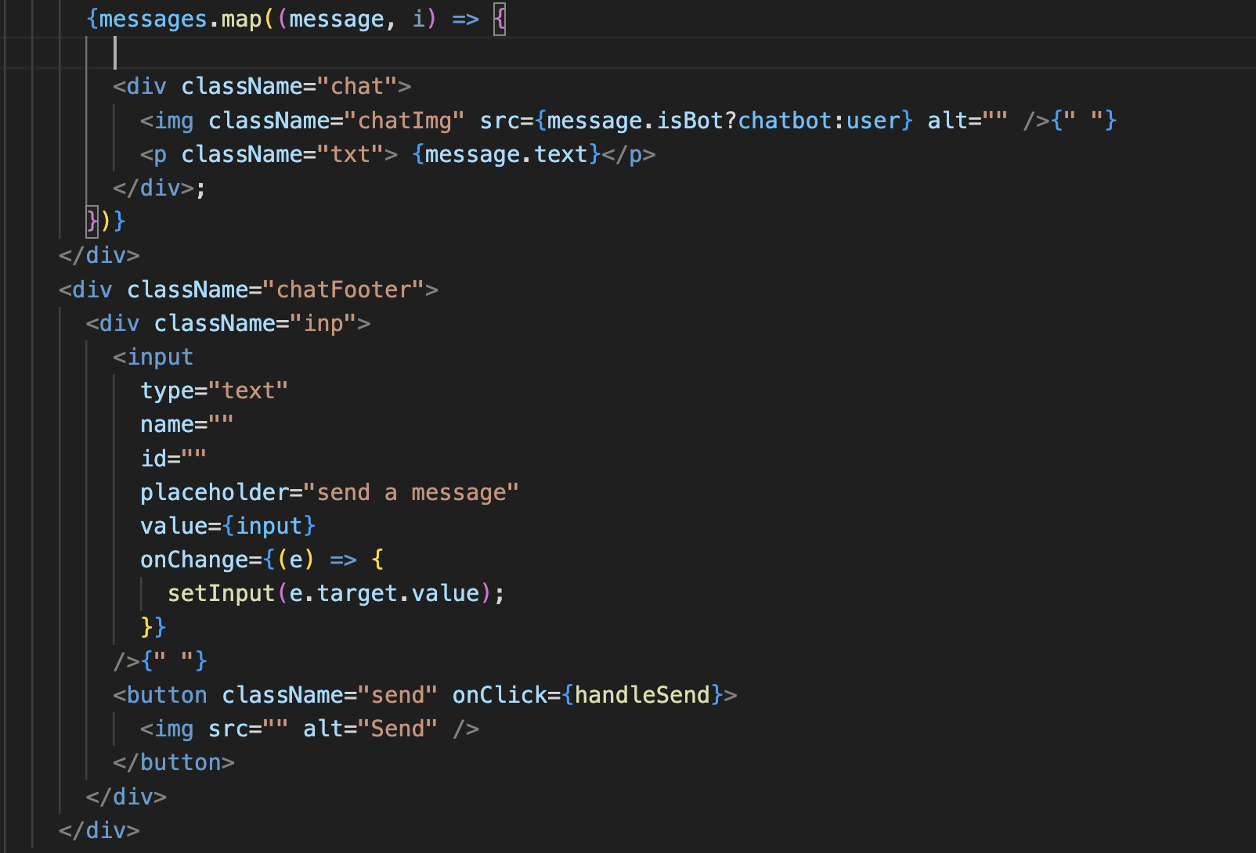
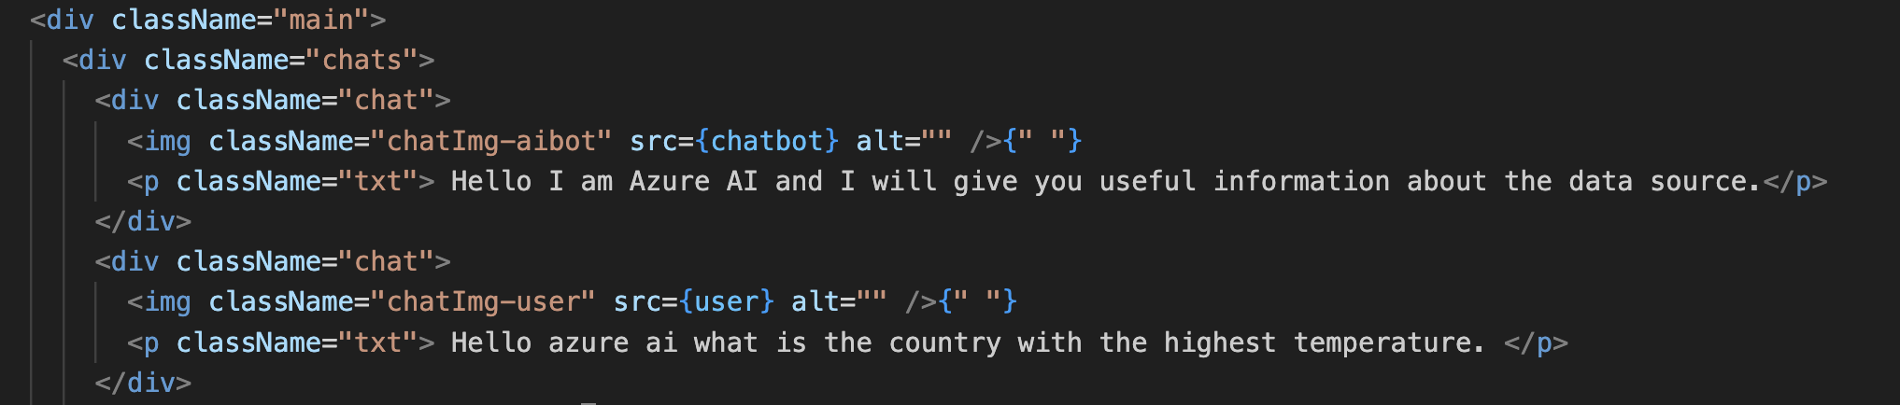
Repo
https://github.com/habioye/Azure-Innovation-Challenge
Notes:
Our code for the front end solution we were working toward is in this repo
Hassan
Hello my name is hassan and I worked on the front end
our repository can be found at this github link
Here is just a few important snippets of the code.
On the left you have the logic for displaying all the chats where the messages would be a list of javascript objects.
They would dynamically be rendered based on the stored message history.
Below that you would see the area where the user would enter their input and send using the send button.
On the right, we have an example of what chat history would look like in html.

Slide 5
Resources Used
Azure OpenAI Studio
Azure SQL database
Azure SQL server
Azure search service
Azure AI chat playground
Github
GitKraken
Google Docs
Notes:
We used quite a few Azure resources in attempting to build this web app/chatbot project.
Hassan
Azure OpenAI Studio - to build, train, and deploy AI models with OpenAI on Azure.
Azure SQL database - to store and querying the relational data.
Azure SQL server - To host the data on azure.
Azure search service - To provide a way for the AI to search for the data.
Azure AI chat playground - To create and test the chat applications..
Github - To host our repository and collaborate.
GitKraken - to give a easy to manage visual overview of the repository as a desktop application
Google Docs - To document our work in real time

Slide 6
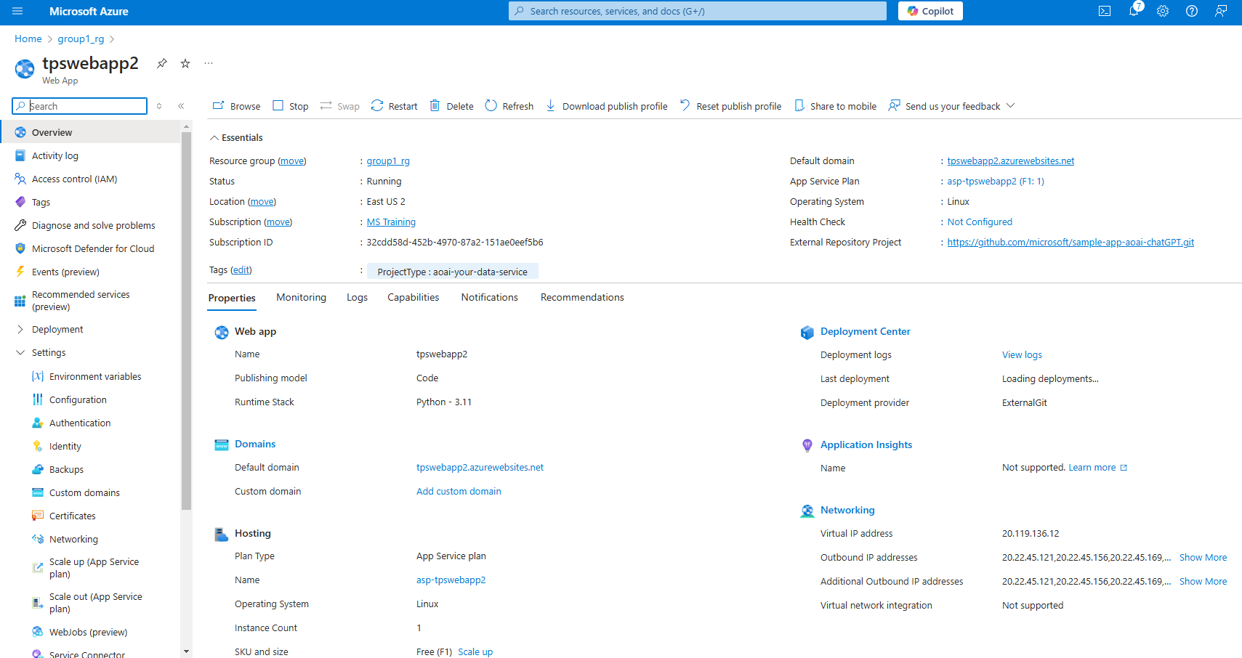
Notes:
We created a web app in Azure OpenAI Studio which was deployable and ready to launch

Slide 7
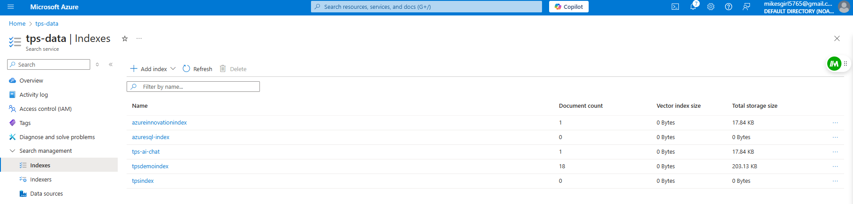
Notes:
As we tried to ingest data, the indexer had trouble reading the sample data sets we tried to ingest

Slide 8
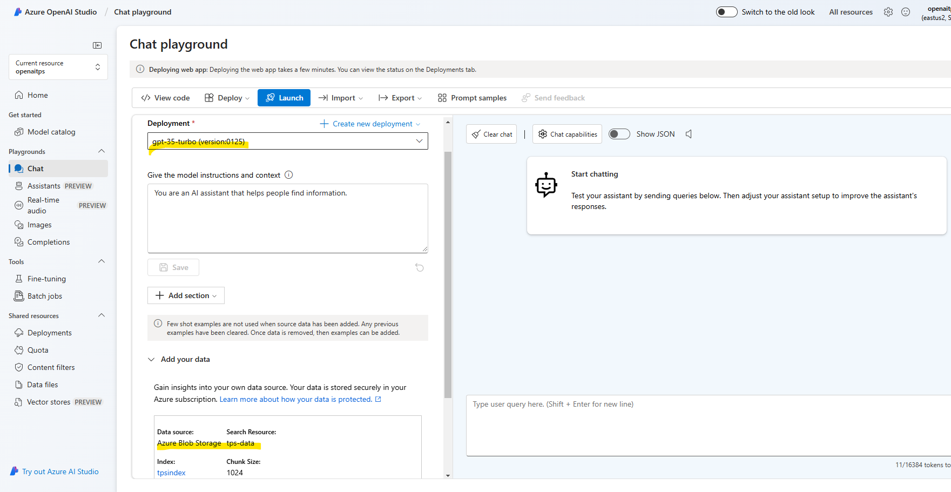
Notes:
In the Azure OpenAI Studio we got our chatbot ready to launch. There was data to pull from, and the launch button was lit

Slide 9
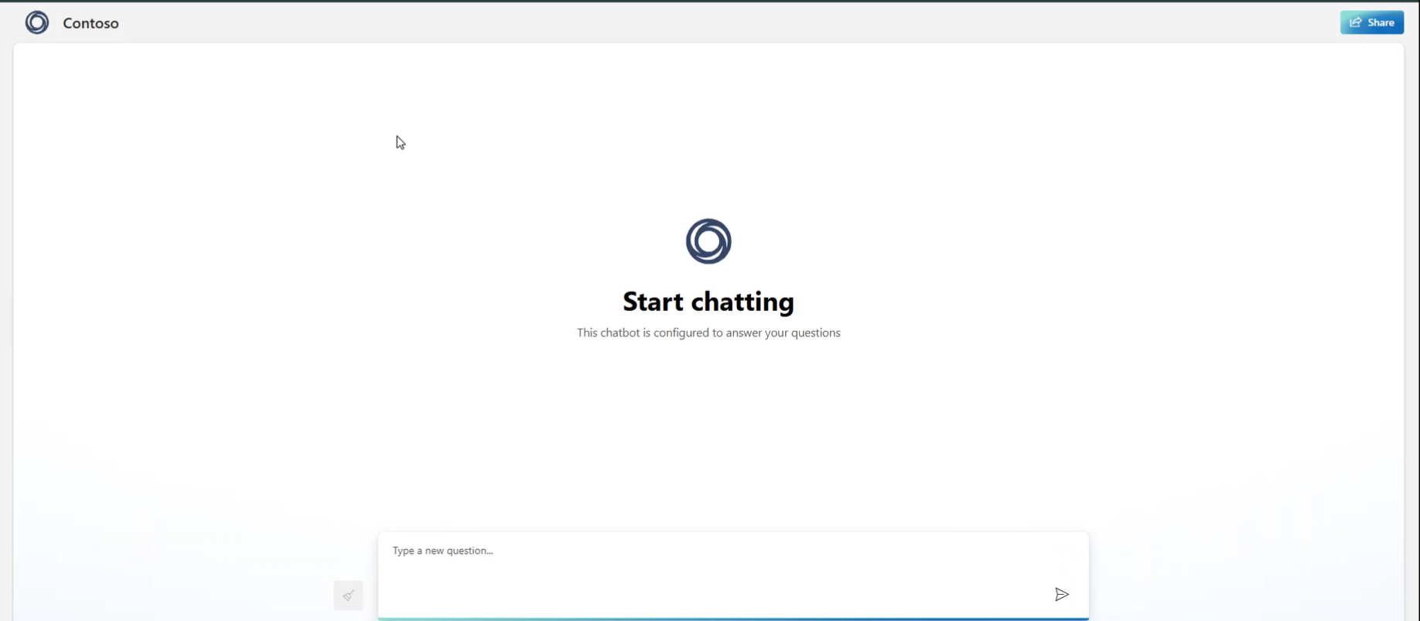
Notes:
For a split second we caught the webapp on video open and ready to start being used.

Slide 10
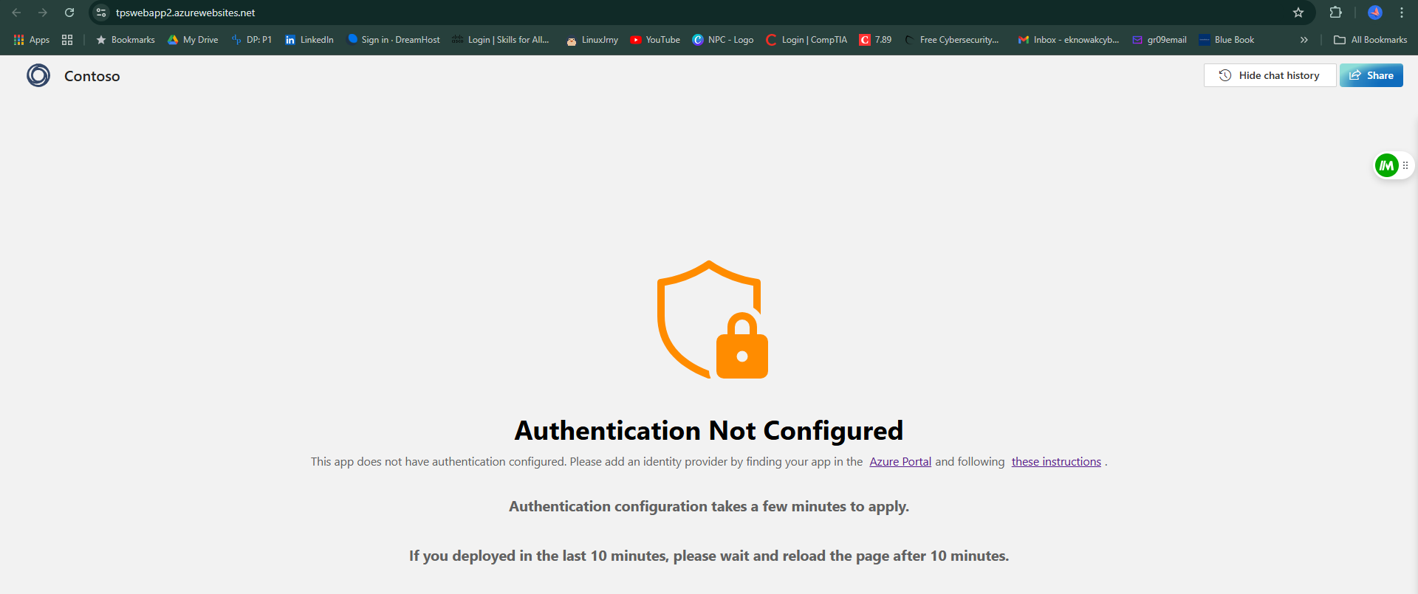
Notes:
However EntraID was the only option allowed and we did not have an EntraID, nor were we able to change our roles and allow access

Slide 11
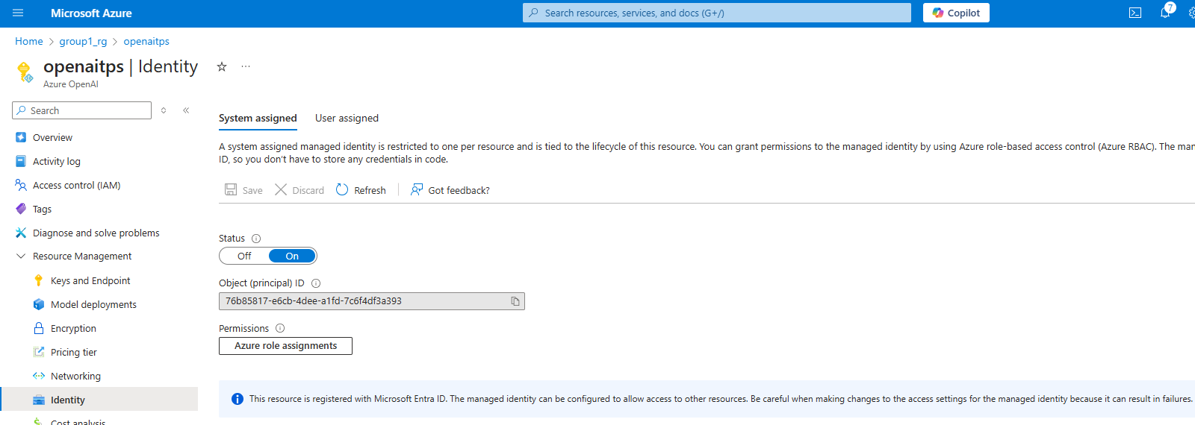
Notes:
We were able to set the app and Open AI account settings to allow for managed identity, but the role assignments option was not available.

Slide 12
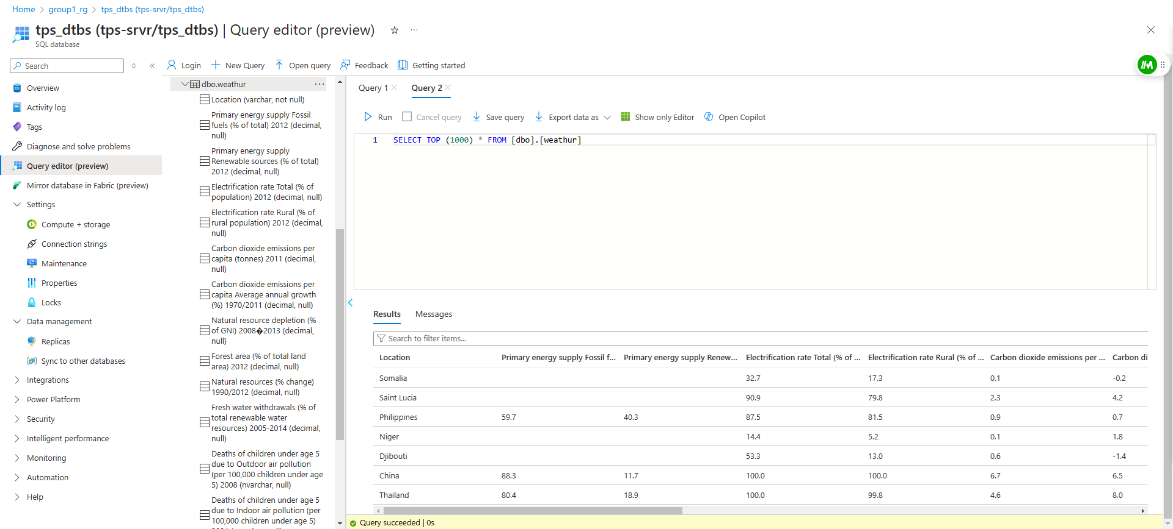
Notes:
Our database was set up to be queried with global energy resources information

Slide 13
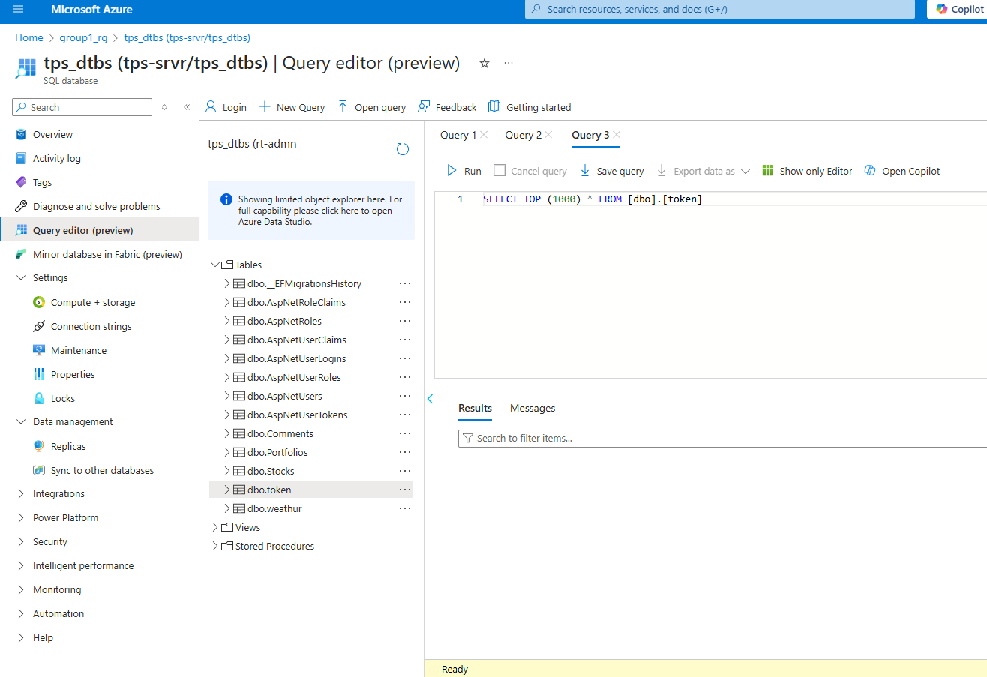
Notes:
The token table was set up to receive data from the chatbot site and allow for it to be called and printed to the site

Slide 14
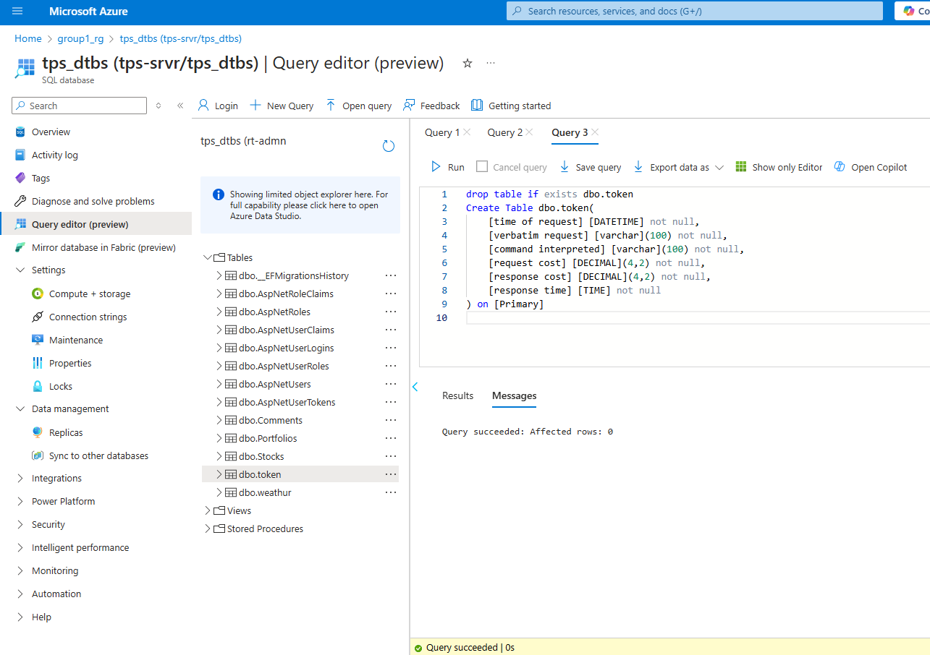
Notes:
Sample query to print token usage cost, request cost, and response costs along with other information

Slide 15
Lessons Learned
Connecting to Azure involves multipale steps across various components—backend, frontend, dta, and AI chatbot. Each of these requires its own instance, incurring separate costs. Instances can be created and attached individually, emphasizing the need to plan for both setup complexity and budget management.
Access management is a key ingredient to Azure resource management. Without proper access, no management is possible, including cost oversight.
Mentors are necessary, but they should be made aware of the different projects and be prepared to guide or help specifically.
Azure AI Studio and Azure OpenAI Studio do not work the same.
Creating web apps and SQL servers is not the same as deploying a web app or a sql database in Azure resources.
Notes:
We would have liked another few days to work through all of the error messages fully, but we did learn a lot about how to create, deploy, and destroy resources.
Hassan

Slide 16
Links to LinkedIn/Github
Hassan-Cloud Software Engineer
https://github.com/habioye
https://www.linkedin.com/in/hassan-abioye-801613186/
Merrick-Full stack Programmer
linkedin.com/in/merrick-brown-4a507313b
Elizabeth-Cybersecurity/AI /junior developer
https://linkedin.com/in/eknowak2024
Kahasim-
https://www.linkedin.com/in/kahasim-brown/
Ane- IT Program Manager
www.linkedin.com/in/annjade
Notes:
Thank you for your time, and for the opportunity to try out all of these resources.

Slide 17
THANK YOU!!!
Special thanks to
Noah Feldman
Kyle Johnson

